Slide 1
INTEGRATED YIELD PREDICTION CROP MANAGEMENT SYSTEM: a case of smallholder farmers
CMT 400 : Research Project Proposal
Name : Latifa Abdallarehan| REG. Num: 1040448
Supervisor: Mr. Ishmael Nicodemus

Slide 2
Content
Background of the Research
Problem Statement
Main & Specific Objectives
Analysis
Design
Implementation

Slide 3
Background of the research
In Kenya, agriculture holds significant economic importance, contributing around 22% directly to the GDP and 27% indirectly through its connections with other sectors. However, agricultural productivity has remained stagnant, due to challenges such as yield uncertainty and lack of modern farming knowledge among farmers reducing the country’s agricultural productivity.
The decline in the country’s agricultural productivity has been seen as an underlying cause of food insecurity, and this has significantly contributed to surge in food prices.
This research is motivated by a strong commitment to improve agriculture in Kenya with modern technology to make farming efficient, productive, and sustainable. The main focus is to ensure farmers get better information about how to optimize yield production as well as managing their crops efficiently.

Slide 4
Main & Specific Objectives
To design and implement an integrated yield prediction crop management system tailored to cater to smallholder farmers to enhance their productivity.
To monitor and predict crop yields based on weather patterns, crop status, historical data, and other factors affecting the crops using machine learning models.
To collect and store data on the status of the crops, soil conditions, weather data, as well as other factors that affect the growth of the crops.
To provide recommendations on crop management practices such as irrigation that will optimize yield production using machine learning

Slide 5
Analysis(1)
Functional requirements
User Interaction: User Registration, Farm Registration, Crops Registration
Data collection using Soil sensors and Weather API Integration
Yield prediction
Provision of recommendations
Non- Functional requirements
User friendly User Interface
Responsive Design
Compatibility
Availability
Efficiency
Reliability

Slide 6
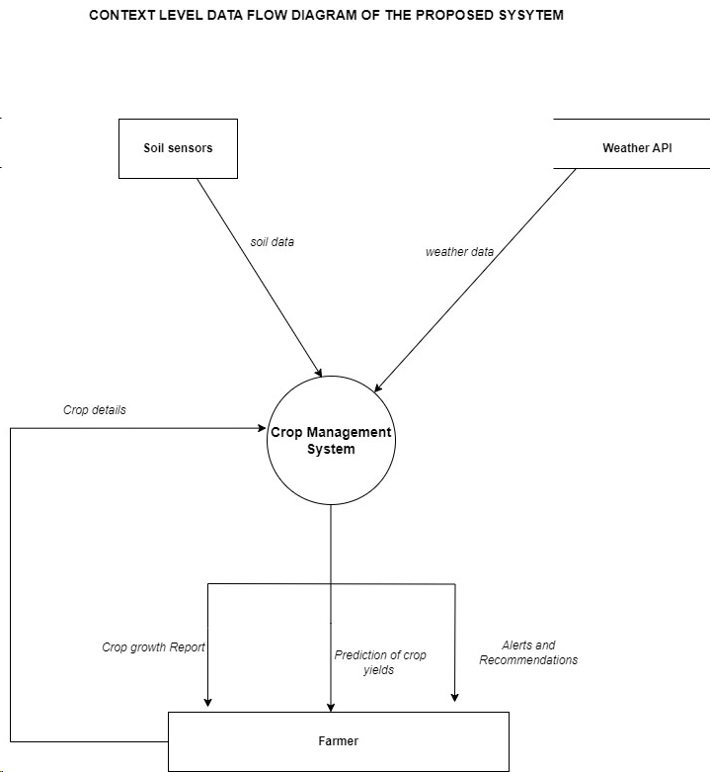
Analysis(2)

Slide 7
Analysis(3)
System users/actors
Farmer, Administrator
System Input/ Input forms
Crop details, farm information, soil data, weather data
System output/ Reports
Predicted yield, crop growth report, recommendations, farm reports
System Entities
Crop, Farm, Farmer, Soil, Weather

Slide 8
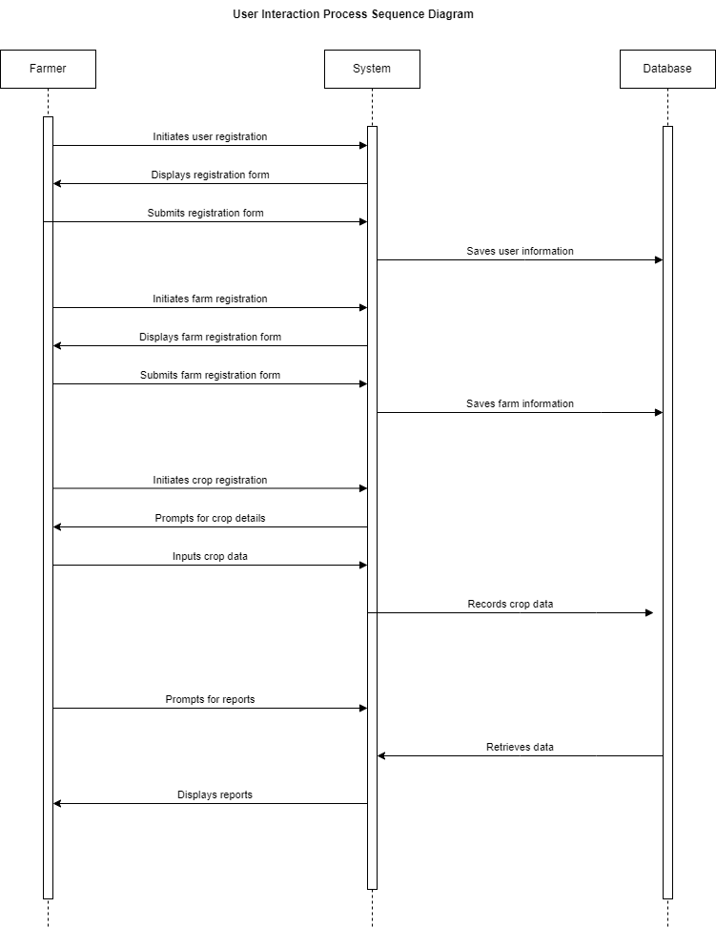
System Design (1):Process Design

Slide 9
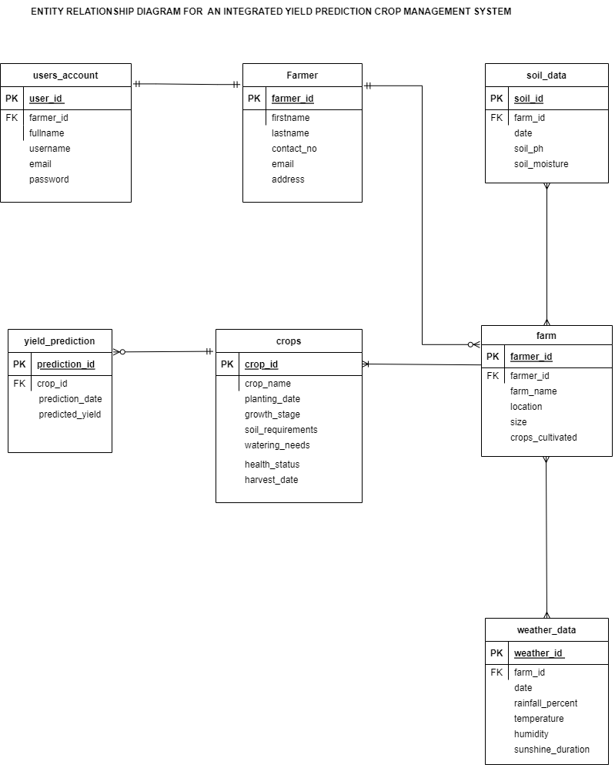
Design(2):Entity Relationship Diagram

Slide 10
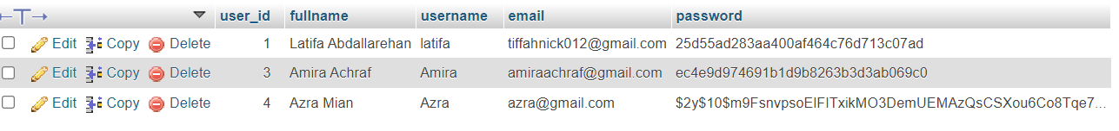
Design(3)
Test data for Registration
First Name: Ilham Omar
Username: Ilham
Email: omarilham@gmail.com
Password: Password
Registration with an Existing Email:
First Name: Azra Khazi
Surname: zeeKhazi
Email: azra@gmail.com
Password: Ronaldo

Slide 11
Design(3)
Test data for Login
Email: azra@gmail.com
Password: 12345678
Login with Incorrect Password:
Email: azra@gmail.com
Password: Incorrect
Login with Non-Existing Email:
Email: alexsaint@gmail.com
Password: Ferrari

Slide 12
Implementation
Landing Page(WIP)
Sign Up
Sign In
Dashboard(WIP)

Slide 13
The End
Thank you

